Slide 1
Project Title
SafePilot: Real-Time ADAS Perception Dashboard
An AI-Powered Driver-Assistance System with an Interactive Web Dashboard
Presented by
Sr. | Name | Roll No.
1 | Uday Annasaheb Thete | 0124ucsm2005
2 | Parth Milind Kulkarni | 0124ucsm2003
3 | Mahesh Tulsiram Shinde | 0124ucsm2008
4 | Vaibhav Nitin Khandekar | 0124ucsm2007
5 | Krushna Prashant Warule | 0124ucsm2011
Project Guide: Prof. S.A. Shivarkar
Subject: Advance Data Science (PCCO411B)
Department of Computer Engineering

Slide 2
Background / Problem Statement
What problem does the project address?
Why is it important?
Delayed driver reaction: late braking, unnoticed vehicles, lane drift
Road accidents are often caused by delayed reaction
Expensive sensors limit access to driver-assistance research
A dashboard makes results easy to demonstrate, monitor and control
Commercial ADAS relies on expensive radar and LiDAR hardware
A low-cost system using only a single camera is needed
The original version ran only from a command line, hard to demo, monitor or control

Slide 3
Proposed Solution
SafePilot analyses dashcam video in real time
Single low-cost camera
Open-source AI models, no radar or LiDAR
Detects and tracks vehicles and pedestrians
Estimates the distance of each object
Predicts collision risk using time-to-collision (TTC)
Monitors lane position and lane departure
Shows everything on a live web dashboard
Interactive dashboard
Click any object to lock on; thresholds adjustable live
Improved over the command-line version
Browser dashboard, aspect ratio preserved, TTC in real seconds

Slide 4
Objectives
1
Detect and track road users in real time
Scope
Estimate distance and time-to-collision (TTC) from a single camera
Input: video file, webcam, server camera or RTSP stream
Perception from a single camera feed
Research and demonstration prototype
Not intended for use in real vehicles
2
3
Classify collision risk as Safe, Caution, Warning or Critical
4
Detect lane position and lane departure
5
Present all results in an interactive browser-based dashboard

Slide 5
Methodology / Working
Video Source
(file, webcam, RTSP)
frames
Perception Engine
(AI + computer vision)
results
Flask Server
Browser
Dashboard
video stream + telemetry
1. Detection
YOLOv8 finds pedestrians, cyclists and vehicles
2. Tracking
ByteTrack gives each object a persistent ID
3. Depth
MiDaS depth map gives per-object distance
4. Lane analysis
Canny, Hough lines and polynomial fit
5. Segmentation
Lightweight road and sky overlay
6. Risk engine
TTC from closing speed and distance
TTC = distance ÷ closing speed → Critical / Warning / Caution / Safe (thresholds adjustable live)

Slide 6
Technologies Used
Programming Language
AI / Vision Models
Python (backend and AI pipeline)
JavaScript, HTML and CSS (dashboard)
YOLOv8n (Ultralytics) for detection
ByteTrack for tracking, MiDaS for depth
OpenCV for lane detection
Framework / Software
Hardware & Input Sources
Flask with MJPEG stream and Server-Sent Events
PyTorch
Chart.js and Canvas
CUDA GPU or CPU (GPU recommended)
Single camera: video file, webcam or RTSP stream
Demonstrated on a CPU-only machine

Slide 7
Expected Outcome / Result
What the system achieves
Limitations
Future Scope
Real-time detection and tracking of road users
Distance and TTC from a single camera
Four-level collision risk and lane-departure alerts
Interactive dashboard with event log and CSV export
Monocular distance is an estimate, not ground truth
Lane detection may struggle at night, in rain or with faded markings
CPU-only machines run slower; GPU recommended
Deep-learning lane model (LaneNet, UFLD)
Traffic-sign and traffic-light recognition
Camera calibration for metric distances
Radar or LiDAR fusion
Edge deployment (Jetson, Raspberry Pi)
Conclusion SafePilot shows that a single camera, open-source AI models and a web dashboard are enough for a practical ADAS prototype. It is low-cost, interactive and extensible.

Slide 8
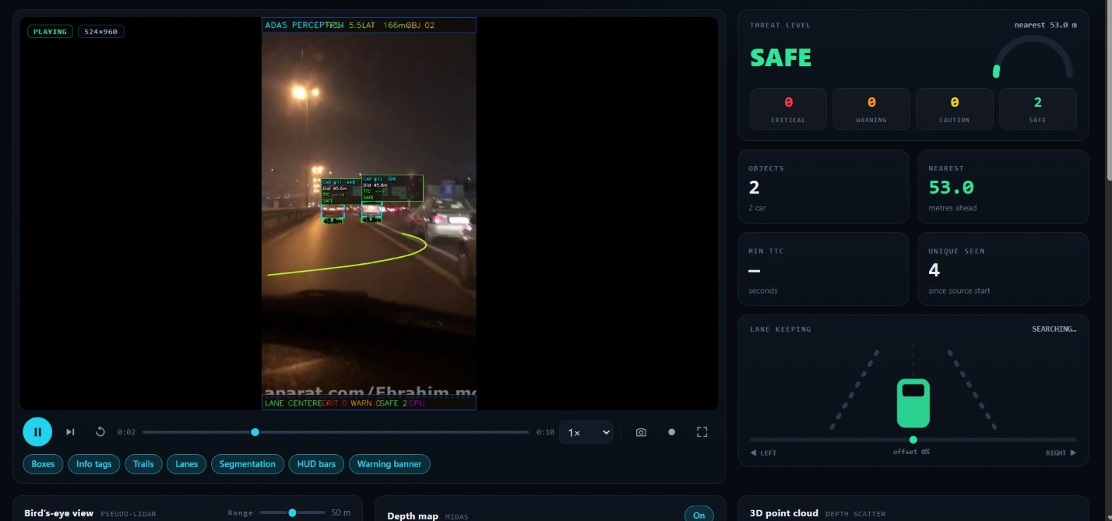
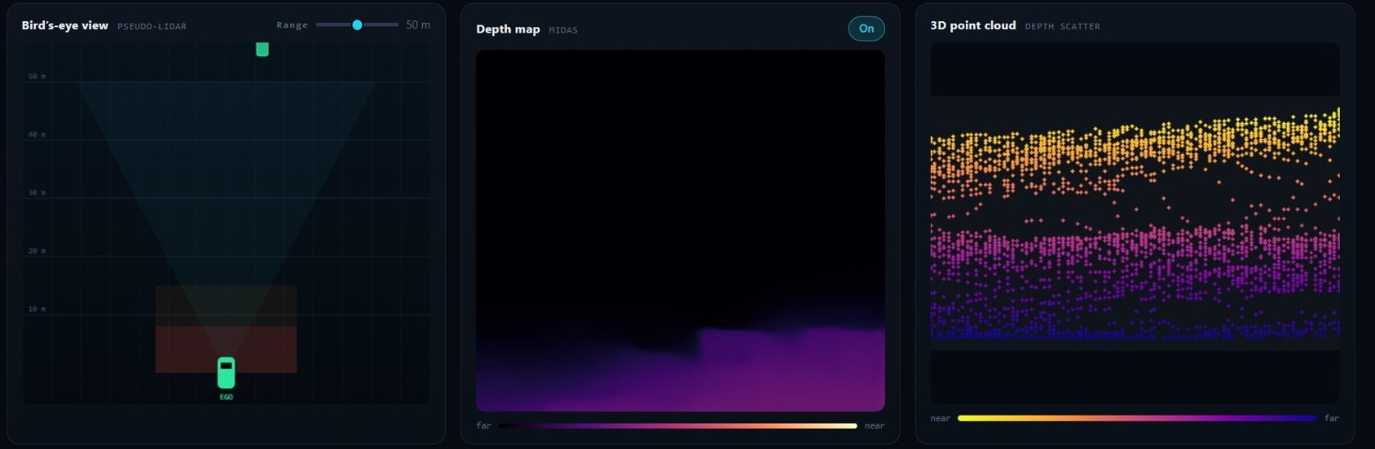
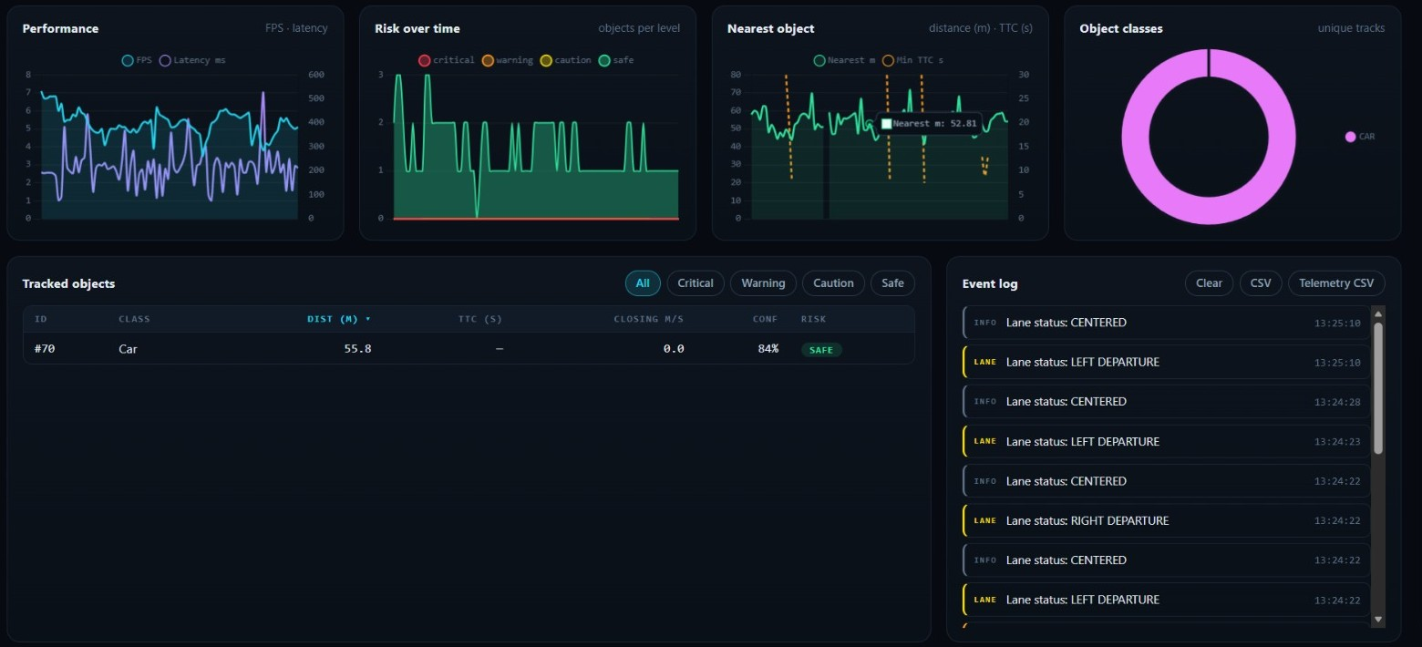
Expected Outcome / Result: Dashboard Screenshots
Fig. 2: Bird's-eye view, depth map and 3D point cloud
Fig. 1: Live detection, threat level, KPI cards and lane keeping
Observed in a demo run on CPU: about 5 FPS, latency 100–320 ms (test video).
Fig. 3: Live charts, tracked objects and event log

Slide 9
References
Research Papers
Software and Documentation
[1] Y. Zhang et al., "ByteTrack: Multi-Object Tracking by Associating Every Detection Box," European Conference on Computer Vision (ECCV), 2022. https://arxiv.org/abs/2110.06864
[2] R. Ranftl, K. Lasinger, D. Hafner, K. Schindler and V. Koltun, "Towards Robust Monocular Depth Estimation: Mixing Datasets for Zero-shot Cross-dataset Transfer," arXiv:1907.01341. https://arxiv.org/abs/1907.01341
[3] J. Canny, "A Computational Approach to Edge Detection," IEEE Trans. Pattern Analysis and Machine Intelligence, vol. 8, no. 6, 1986. https://doi.org/10.1109/TPAMI.1986.4767851
[4] G. Jocher, A. Chaurasia and J. Qiu, "Ultralytics YOLOv8," 2023. https://docs.ultralytics.com/models/yolov8
[5] OpenCV documentation. https://docs.opencv.org
[6] Flask documentation. https://flask.palletsprojects.com
[7] PyTorch. https://pytorch.org
[8] Chart.js. https://www.chartjs.org
[9] Project repository. https://github.com/uday6725
Thank You | Questions?

Slide 10
